Slide 1


SAP BTP CPI Training

Slide 2

DISCLAIMER
The training content and delivery of this presentation is confidential, and cannot be recorded, or copied and distributed to any third party, without the written consent of Anubhav Trainings

Slide 3


Introduction

Slide 4
Agenda
Process Direct
SOAP adapter
SOAP UI to CPI integration
Local Integration Process
Process call

Slide 5
SOAP ADAPTER
The SOAP adapter enables you to exchange SOAP messages between remote clients or Web service servers and the Integration Server. The receiver SOAP adapter also allows you to send SOAP messages using the SMTP protocol. You can specify security settings to be used to sign/verify the SOAP body.

Slide 6
SOAP RM
The SOAP (SAP RM) Sender Adapter exchanges messages with a sender system based on the SOAP communication protocol (1.1. and 1.2) and SAP Reliable Messaging (SAP RM) as the message protocol. SAP RM is a simplified communication protocol for asynchronous Web service communication that does not require the use of Web Service Reliable Messaging standards. A size limit for the inbound message can be configured for the sender adapter.

Slide 7
Address | Relative endpoint address at which the ESB listens to the incoming requests, for example, /HCM/GetEmployeeDetails.
URL to WSDL | URL to the WSDL defining the WS provider endpoint (of the receiver). You can specify the WSDL by selecting a source to browse for a WSDL either from an On-Premise ES Repository or your local workspace.

Slide 8
Processing Settings | This feature corresponds to an older version of this adapter. The reason why it is shown can be that you either have selected a certain product profile other than SAP Cloud Integration or (in case you have selected SAP Cloud Integration product profile) that you continue editing an integration flow which exists already for a certain time

Slide 9
Authorization | Specifies the authorization option for the sender.

Slide 10
SOAP (SOAP 1.x) Adapter
onnection
Parameter | Description
Address | Relative endpoint address on which the integration runtime expects incoming requests, for example, /HCM/GetEmployeeDetails.
The SOAP (SOAP 1.x) sender adapter enables a SAP BTP tenant to exchange messages with a sender system that supports Simple Object Access Protocol (SOAP) 1.1 and 1.2.
C

Slide 11
Service Definition | The service definition consists of a service, an endpoint, and the exchange pattern. For one-way services, you can additionally specify the runtime behavior. You can select the following options:Manual: Set this option to use the service definition provided by the system and define the message exchange pattern manually. The default service definition provides a generic message format. WSDL: Set this option to use a service definition from a WSDL provided in the adapter configuration. This will also include the message formats.

Slide 12
Use WS-Addressing | Select this option to accept addressing information from message information headers (provided by the sender) during runtime.

Slide 13
Message Exchange Pattern (only if Service Definition: Manual is selected) | Specifies the kind of messages that are processed by the adapter.Request-Reply: When selected, the adapter processes both request and response (synchronous message exchange) One-Way When selected, the message is processed asynchronously. Use this option if in your scenario the sender just needs to initiate the request without being interested in getting to know if the request is processed successfully. .

Slide 14
To select the WSDL from a source, you've the following options:
Select a WSDL from your file system.
Select a WSDL from your integration flow resources

Slide 15
Service(only if as Service Definition the option WSDL is selected) | Name of the selected service contained in the referenced WSDL.
Endpoint (only if as Service Definition the option WSDL is selected) | Name of the selected endpoint of a selected service (that you provide in the Service Name field) contained in the reference

Slide 16
Processing Settings (only relevant for the one-way exchange pattern) | WS Standard: Message is executed with WS standard processing mechanism. Errors aren't returned to the consumer. Robust: WSDL provider invokes service synchronously and the processing errors are returned to the consumer.

Slide 17
Authorization | Specifies the authorization option for the sender. Client Certificate: Sender authorization is checked on the tenant by evaluating the subject/issuer distinguished name (DN) of the certificate (sent together with the inbound request). You can use this option together with the following authentication option: Client-certificate authentication (without certificate-to-user mapping). User Role: Sender authorization is checked based on roles defined on the tenant for the user associated with the inbound request. You can use this option together with the following authentication options: Basic authentication (using the credentials of the user) The authorizations for the user are checked based on user-to-role assignments defined on the tenant. Client-certificate authentication and certificate-to-user mapping

Slide 18
SOAP Sender Adapter: Example Integration Flow
You can easily modify the integration flow described in the Getting Started section by adding a SOAP client as sender.
The figure shows the integration flow model that you get as a result of this exercise.

Slide 19
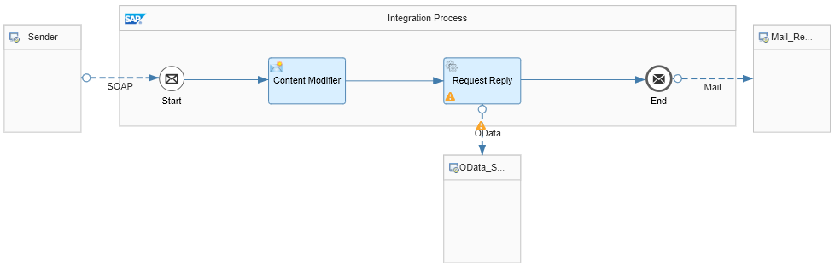

Slide 20
In the modified integration flow, a SOAP client instead of a Timer event triggers message processing.
This is how the integration flow processes the message at runtime:
The SOAP client (represented by the Sender shape) sends a Simple Object Access Protocol (SOAP) message toSAP Cloud Integration through a SOAP (SOAP 1.x) sender channel.
The SOAP message contains a product identifier.
The Content Modifier creates a message header (which we also call productIdentifier) and writes the actual value of the productIdentifier element into it. This header will be used in the subsequent step.
The Request Reply step passes the message to an external data source and retrieves data (about products) from there.
The external data source (which is represented by the lower WebShop shape) supports the Open DataProtocol (OData). For our scenario, we use the ESPM WebShop, which is based on the Enterprise Sales and Procurement Model (ESPM) provided by SAP. The demo application can be accessed at the following address: https://espmrefapps.hana.ondemand.com/espm-cloud-web/webshop/
An OData receiver channel is used for the connection to the OData source. To query for exactly one product (for the product identifier provided with the inbound message), the header that was created in the preceding Content Modifier is used.
The OData API provides the details of one specific product, which is identified by the actual value of the productIdentifier field (provided with the inbound SOAP message).
Finally, the result of the request is forwarded to an e-mail account using the Mail receiver adapter (the e-mail server is represented by the right Mail … shape in the integration flow model).

Slide 21
URL to WSDL (only if as Service Definition the option WSDL is selected) | URL pointing to the WSDL defining the WS provider endpoint (of the receiver).

Slide 22
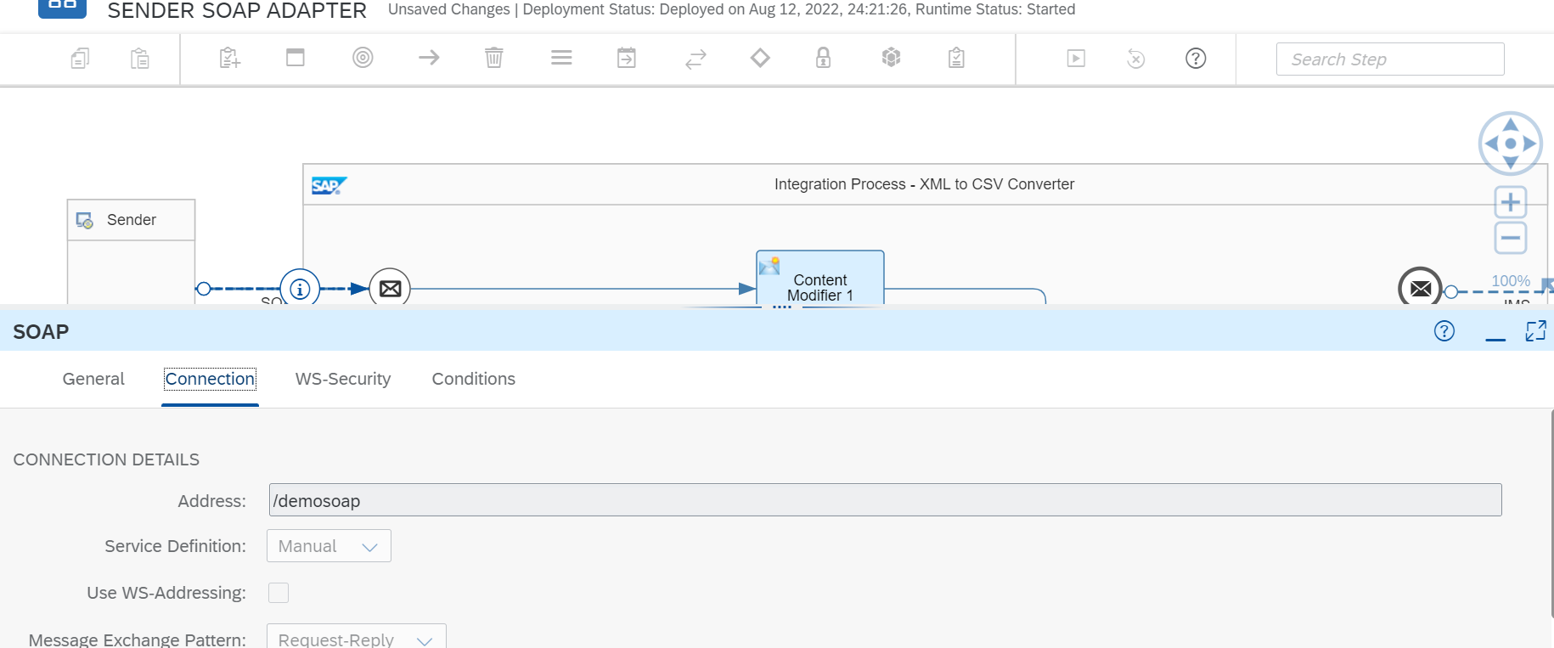
SOAP to SAP CPI

Slide 23
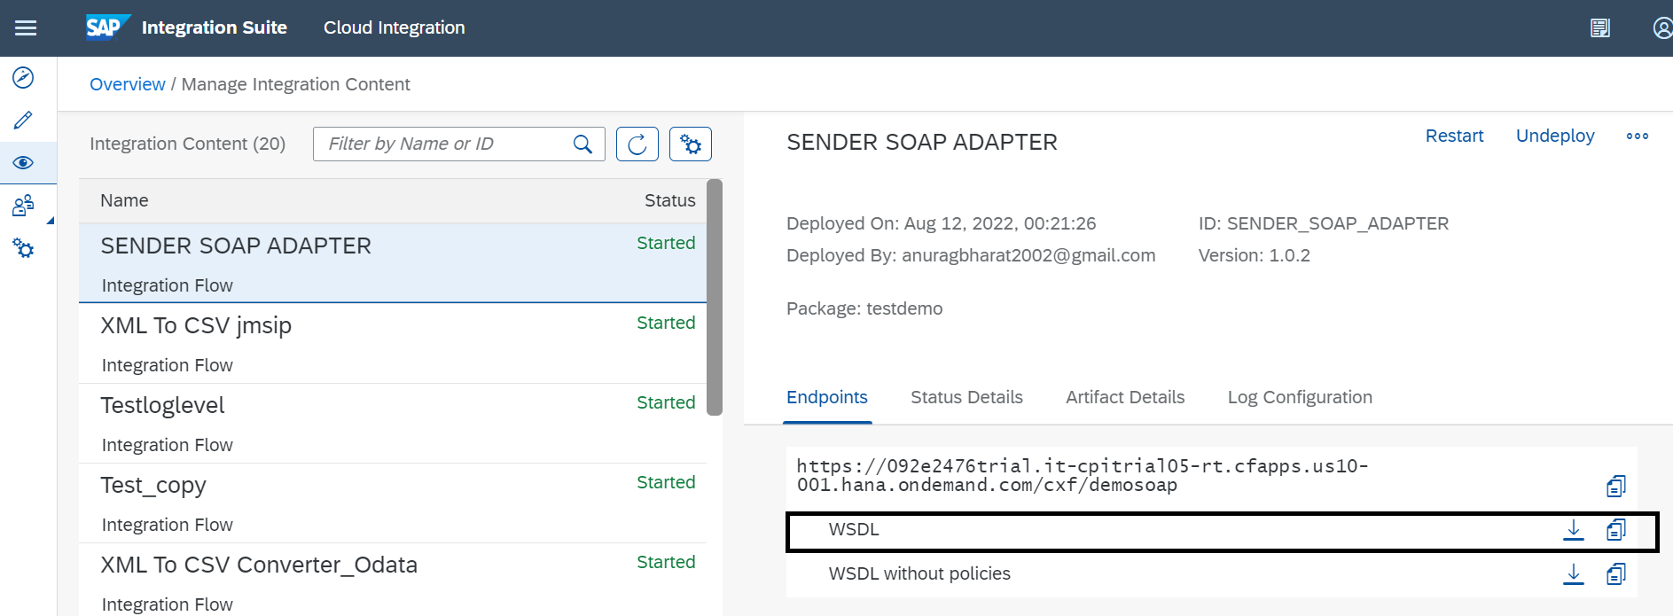
SOAP to SAP CPI

Slide 24
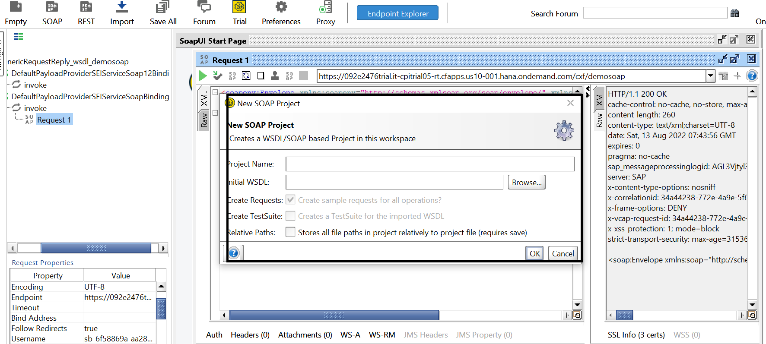

Slide 25
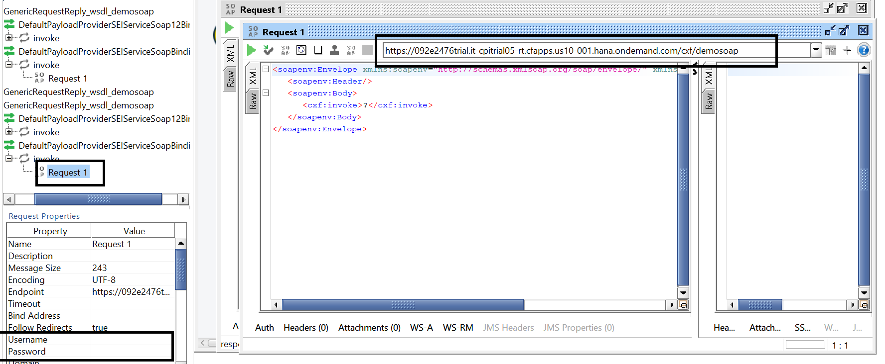

Slide 26
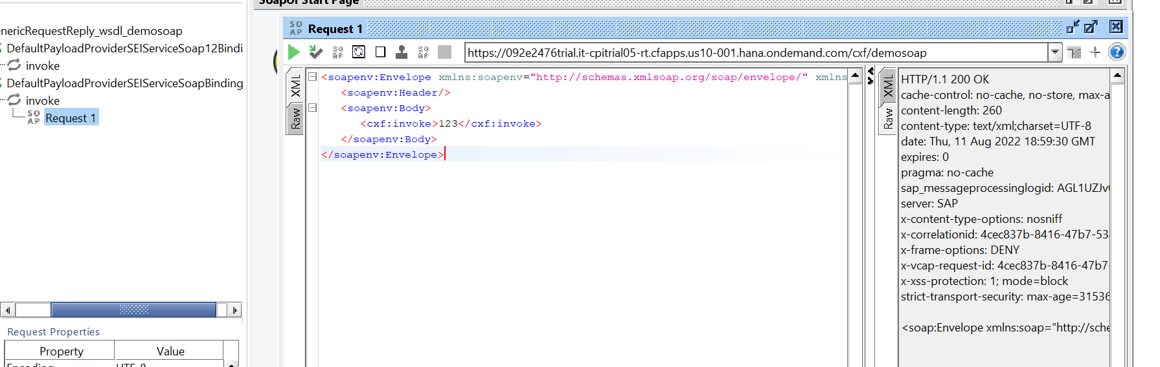
SOAP to CPI

Slide 27
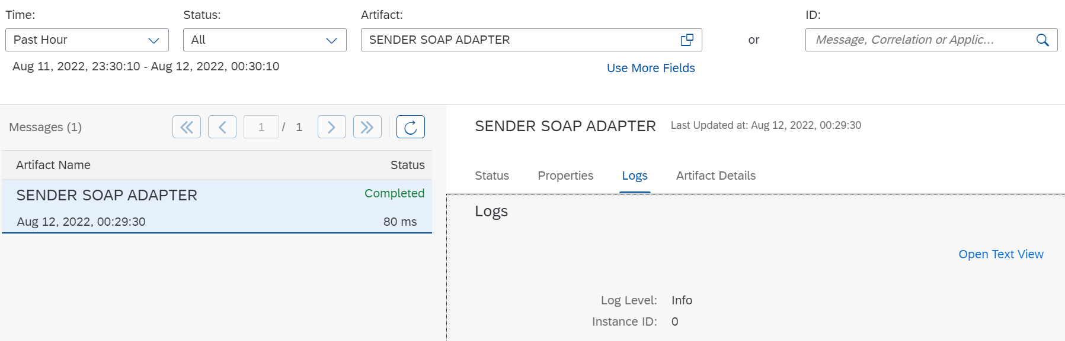

Slide 28
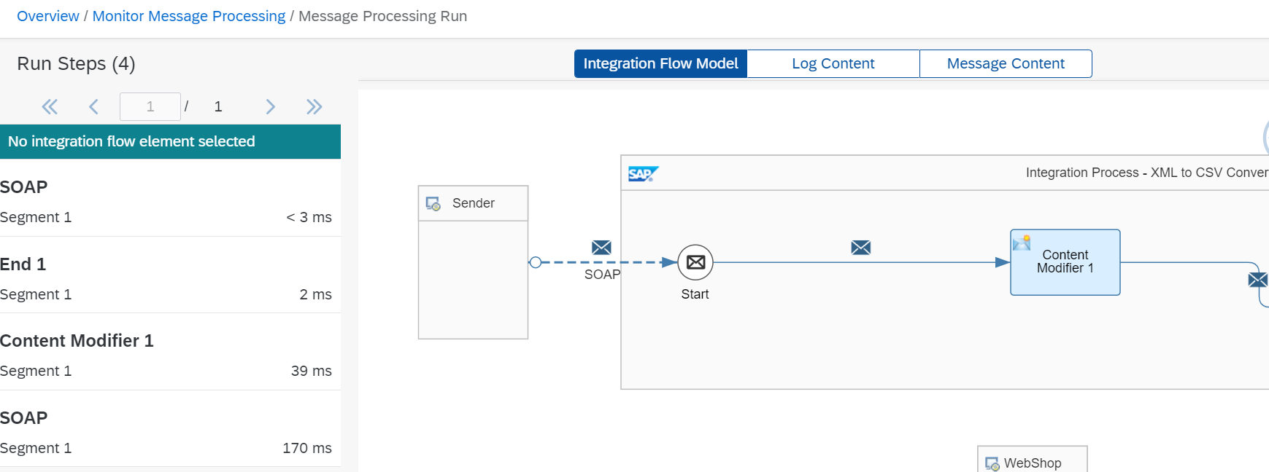
SOAP to CPI

Slide 29
Process Direct
Use ProcessDirect adapter (sender and receiver) to establish fast and direct communication between integration flows by reducing latency and network overhead provided both of them are available within a same tenant.
ProcessDirect Receiver Adapter: If the ProcessDirect adapter is used to send data to other integration flows, the integration flow is considered as a producer integration flow. In this case, the integration flow has a receiver ProcessDirect adapter.
ProcessDirect Sender adapter: If the ProcessDirect adapter is used to consume data from other integration flows, the integration flow is considered as a consumer integration flow. In this case, the integration flow has a sender ProcessDirect adapter.

Slide 30
Process Direct
The ProcessDirect adapter supports the following features: Decompose large integration flows: You can split a large integration flow into smaller integration flows and maintain the in-process exchange without network latency.
Allow multiple integration developers to work on the same integration flow: In some scenarios, integration flows can be large (100 steps or more), and if they are owned or developed by just one integration developer this can lead to an overreliance on one person
Customize the standard content: SAP Cloud Integration enables integration developers to customize their integration flows without modifying them entirely.
Reuse of integration flows by multiple integration processes spanning multiple integration projects:

Slide 31
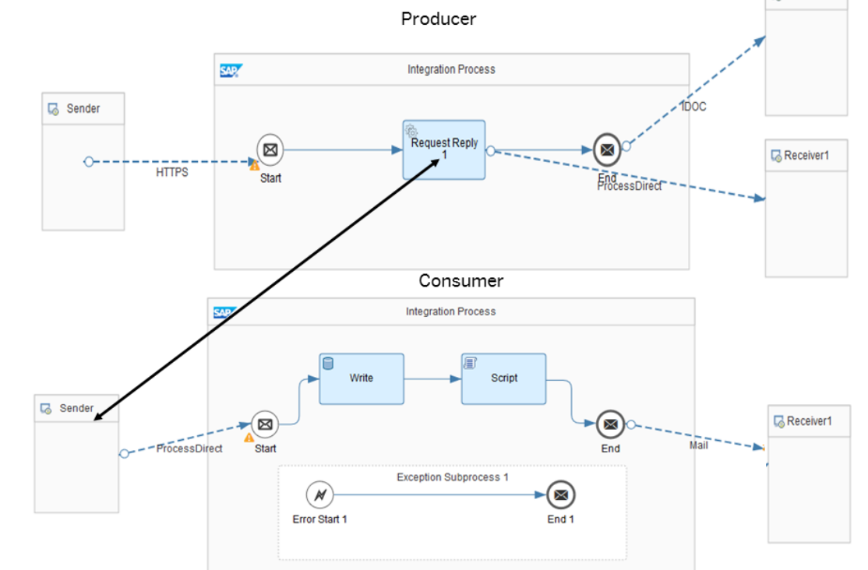
Process Direct

Slide 32
Local integration process
You use the local integration process to simplify your integration process. You can break down the main integration process into smaller fragments by using local integration processes. You combine these fragments to achieve your main integration process.
You use the Local Integration Process to define an integration process that is specific to the integration flow in which it is created. You can use this integration process with the Process Call step.

Slide 33
Local integration process
You cannot use the following integration flow steps within the Local Integration Process step:
Another Local Integration Process
End Message
Sender
Receiver

Slide 34
Local Integration Process
Procedure
Choose the local integration process element you want to configure.
If you want to provide a name for the local integration process element, in the Name field under the General tab, enter name.
If you want to configure the elements inside the local integration process, refer to the documentation relevant to those elements.

Slide 35
Process call
If you want to add the local integration process to a process call element, perform the following substeps:Select the process call element in integration flow editor.
In Local Integration Process field, choose Select.
In Select Local Integration Process window, select the local integration process you want to assign to the process call.

Slide 36
Exception subprocess
You use this element to catch any exceptions thrown in the integration process and handle them.
Procedure
Open your integration flow in the editor.
To add an exception subprocess to the integration flow, choose Process Exception Subprocess from the palette. The subprocess can be dropped into the integration process and should not be connected to any of the elements of the integration flow.
Select the exception subprocess.
In the property sheet specify a name.
Start the process with Error Start event always.
End the process with either End Message or Error End or Escalation event.

Slide 37
You can use an End Message event to wrap the exception in a fault message and send it back to the sender in the payload.
You can use an Error End event to throw the exception to default exception handlers.

Slide 38

Summarize
LET’S SUMMARISE!

Slide 39

Summarize
End of Day 1

Slide 41


We’re committed to empower you to be
#FutureReady
through powerful training solutions.
We build the workforce of the future.
250+
Corporate Clients
30,000+
Learners Trained
25000+
Learners Placed
FREE WEBINARS
Sign up for free webinars with industry experts every fortnight!
Enroll Now!
Contact us today!
https://anubhavtrainings.com

